Slide 1
Title of Project Title: Grocery Ordering App using MERN Stack Subtitle: Streamlining Online Grocery Shopping Team Members: Boris willbert T Darmeshram Praveen raj Santhana vignesh s

Slide 2
Objective:
To create a user-friendly online grocery ordering system that simplifies the shopping experience for users and streamlines operations for grocery stores.

Slide 3
Abstract:
This project focuses on developing a web application using the MERN stack (MongoDB, Express.js, React, Node.js) that allows users to browse and order groceries online. The application aims to enhance the convenience of shopping for groceries while providing an efficient platform for store management.

Slide 4
Existing System:
Overview:
Current systems rely heavily on in-store shopping or basic online catalogs with limited functionality.
Issues:
Lack of real-time inventory updates
Inefficient order management
Poor user experience

Slide 5
Proposed System:
Overview:
A comprehensive web application with a dynamic user interface, robust backend, and real-time database integration.
Front End:
Technologies:
Features: Responsive design, easy navigation, real-time updates
Back End:
Technologies: Node.js,
Features: Secure API endpoints, authentication, order management
Database:
Technologies: MongoDB
Features: Real-time inventory tracking, order storage
Integration:
Connection: RESTful APIs connecting front end with backend for seamless data flow

Slide 6
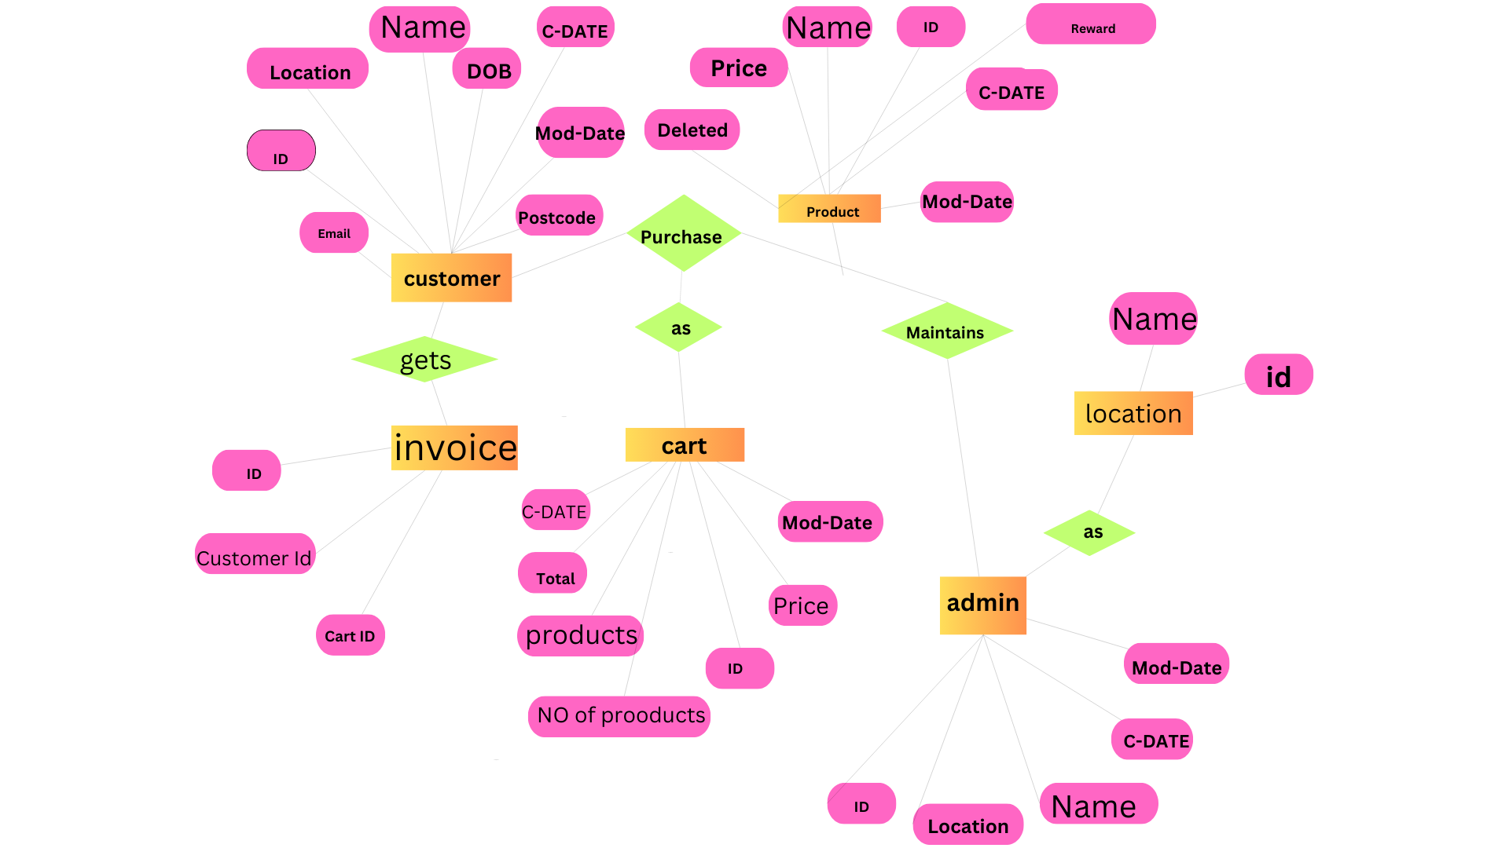
Architecture Diagram:
Diagram:

Slide 7
Explanation:
User Interface: components
API Layer: and
Database: MongoDB for data storage and retrieval

Slide 8
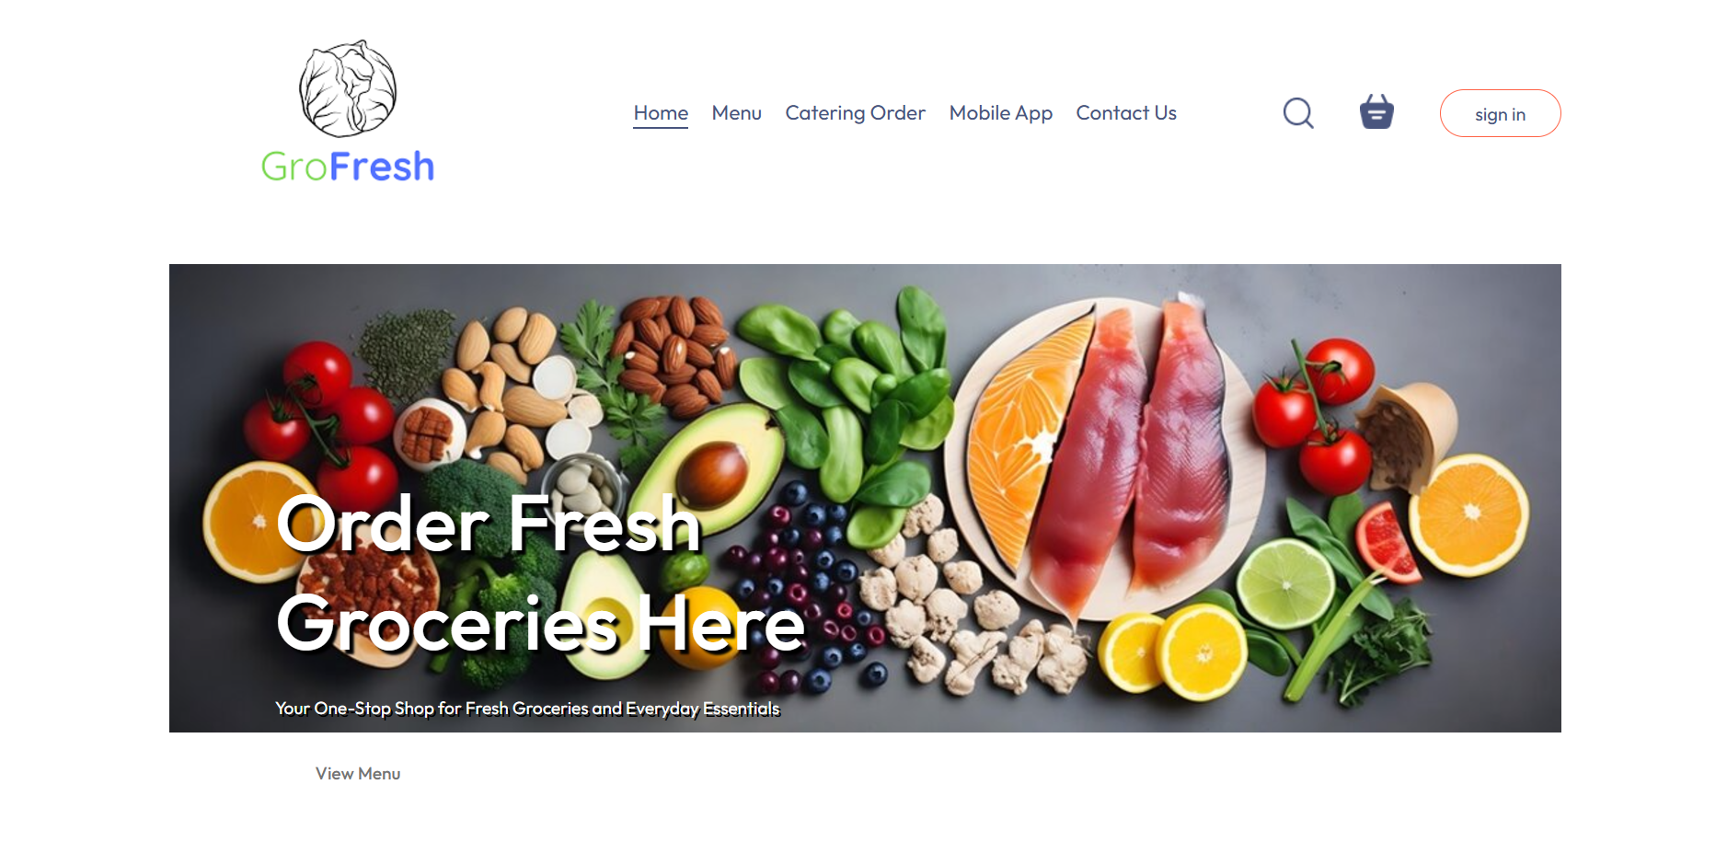
Screenshots:
Homepage:

Slide 9
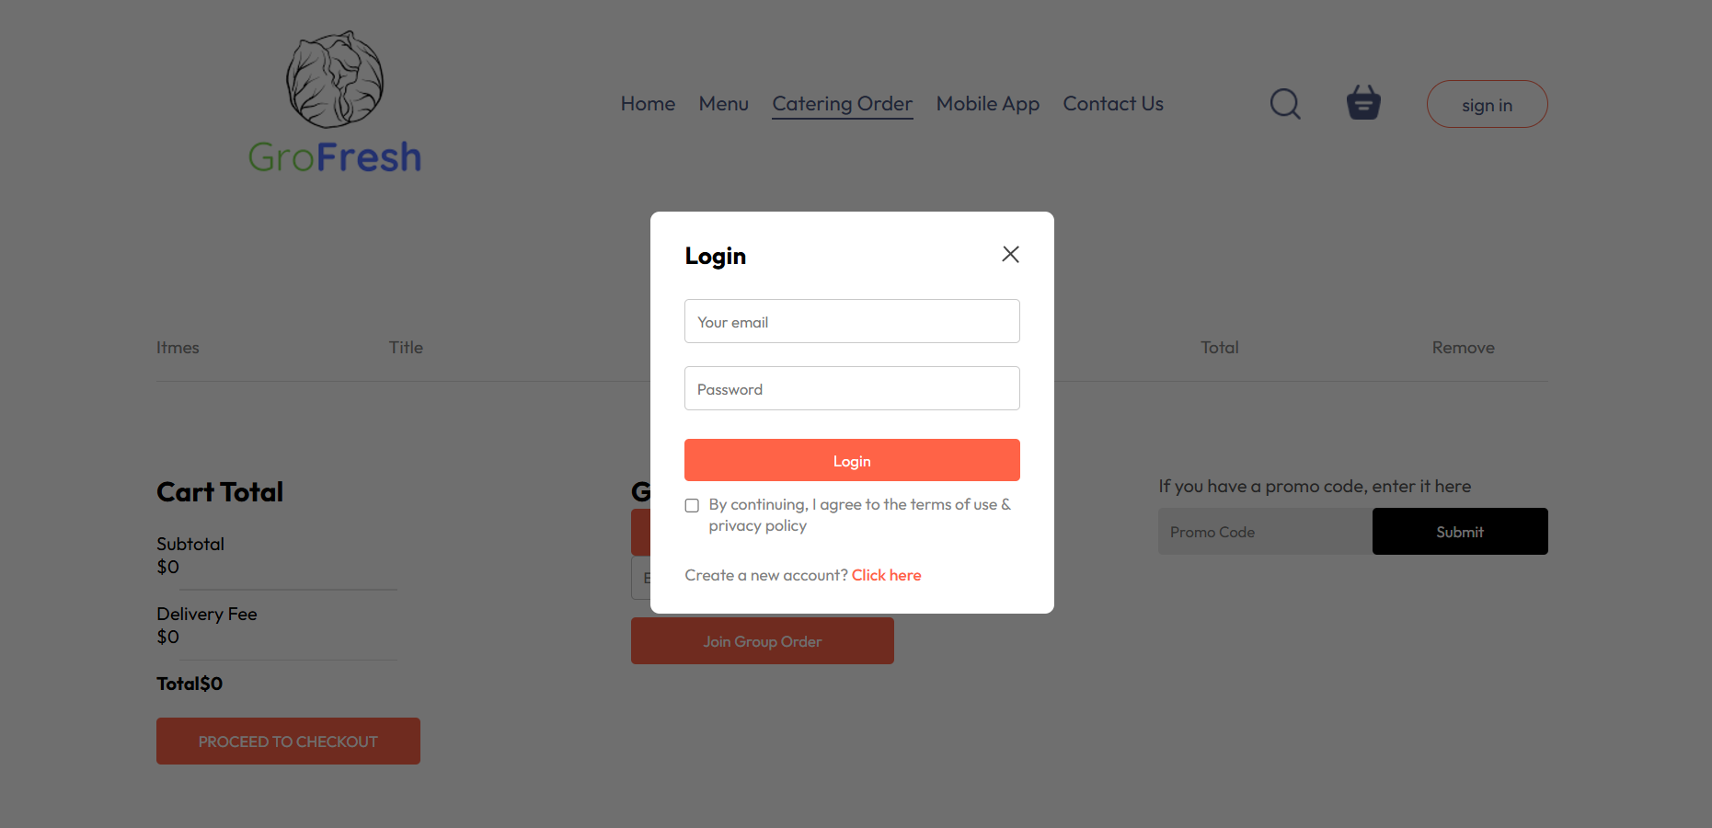

Slide 10
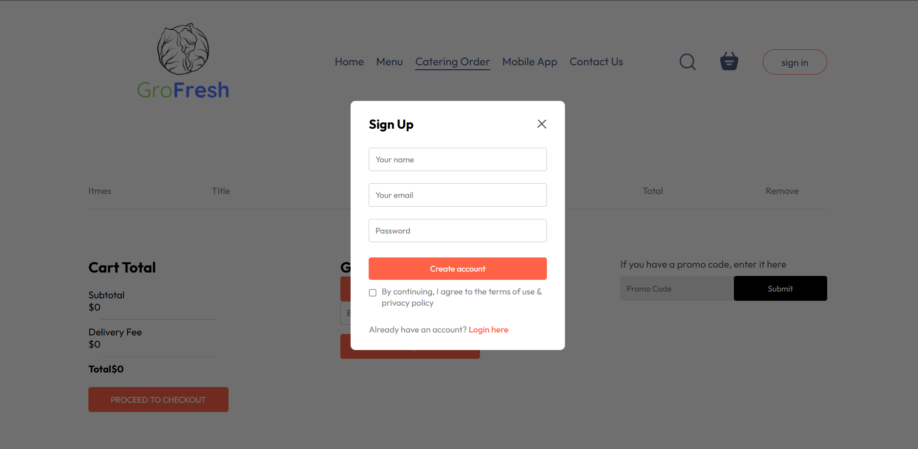

Slide 11
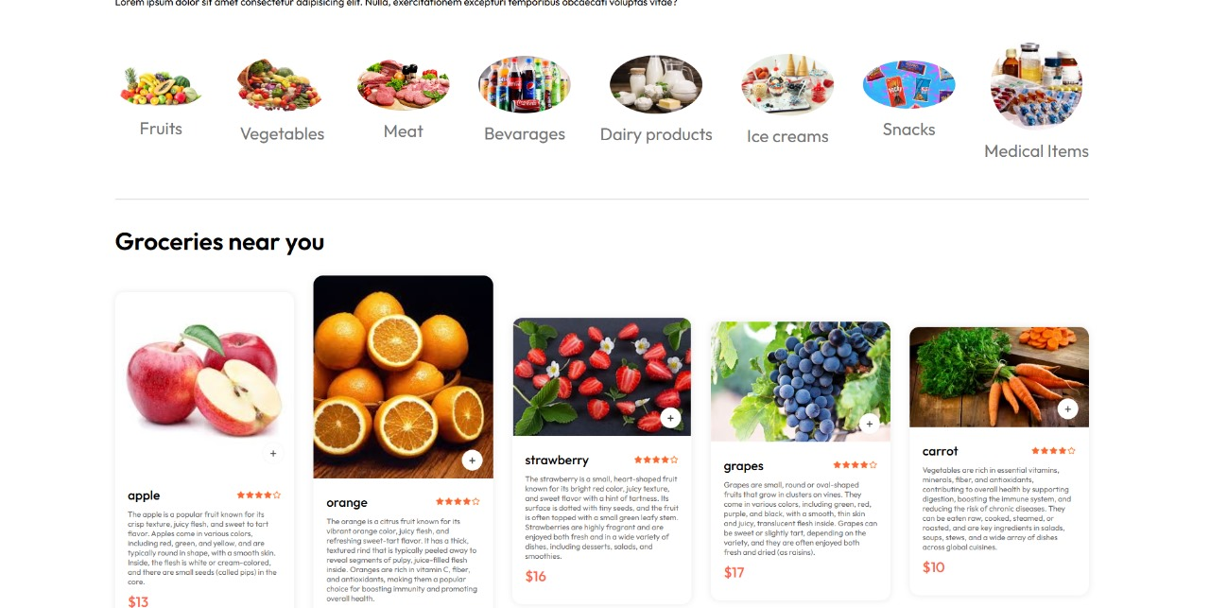
Product Listing:

Slide 12
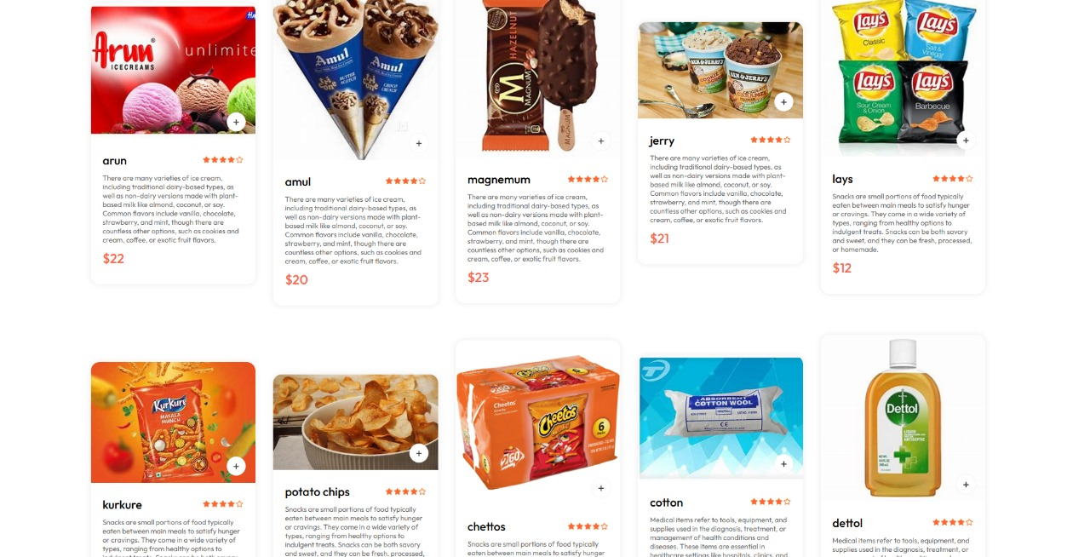

Slide 13
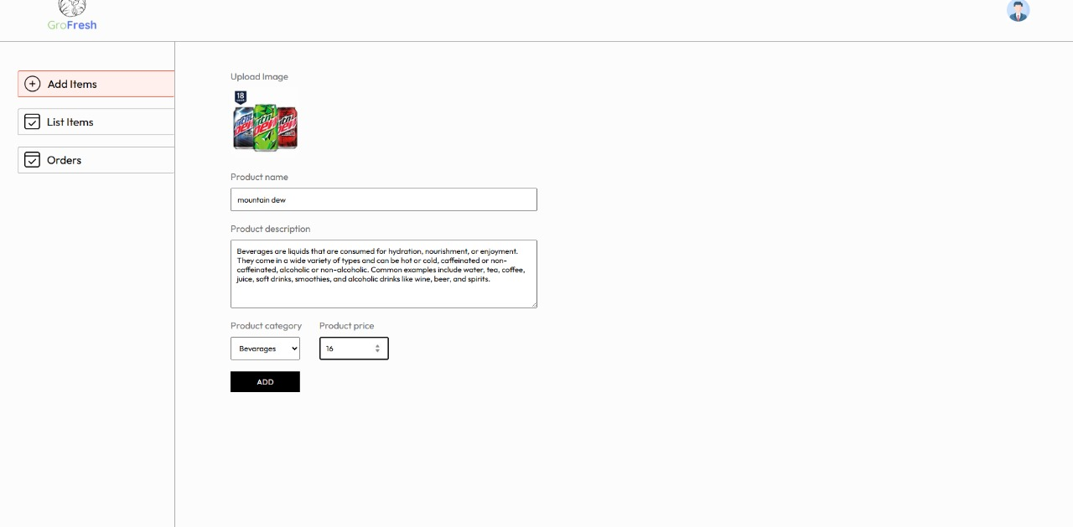

Slide 14
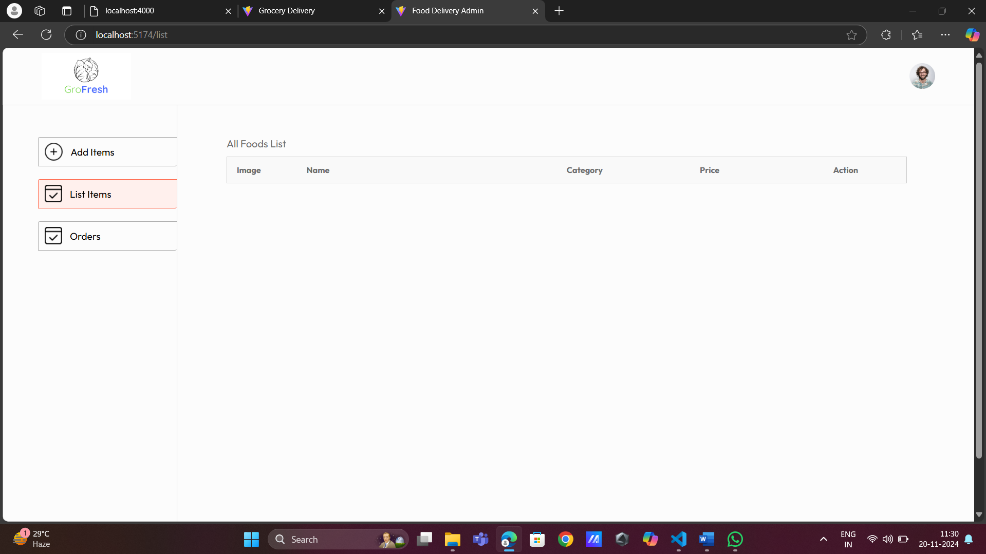

Slide 15
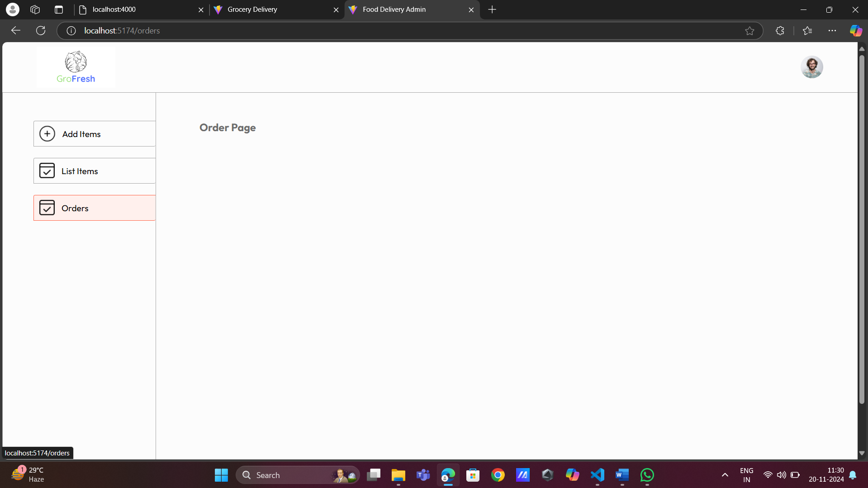

Slide 16
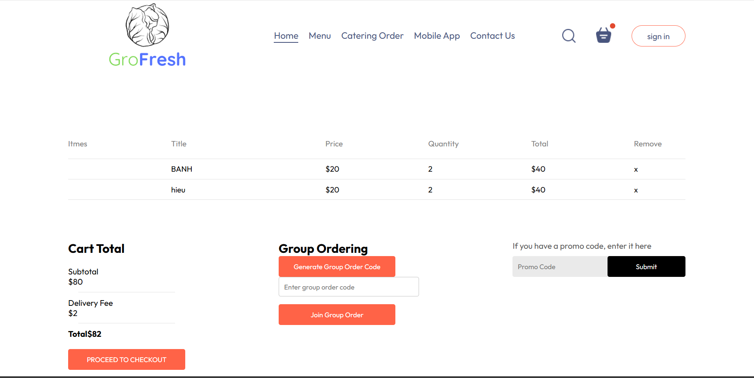
Shopping Cart:

Slide 17
Requirements:
Software Requirements:
MongoDB
Any Code Editor (e.g., VS Code)
Hardware Requirements:
A computer with internet access
Adequate RAM and storage for development

Slide 18
Conclusion:
Summary:
The Grocery Ordering App using the MERN stack aims to provide a seamless and efficient online shopping experience for users, while also simplifying store operations through real-time inventory and order management.
Future Work:
Implementing a recommendation system based on user preferences
Integrating payment gateways for secure transactions
Expanding to mobile platforms

